Slide 1
Department of Computer Science
CS F364 – DESIGN AND ANALYSIS OF ALGORITHMS
LECTURE – GREEDY METHOD
PORTIONS: As specified in handout and the contents taught in class. Class notes is must. Refer to the textbook as mentioned in handout
PLEASE NOTE THAT PPT IS JUST AN ADDITIONAL REFERENCE.

Slide 2
Topic- Greedy Approach
Minimum cost spanning tree
Prims algorithm

Slide 3
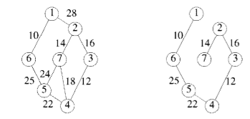
Prims Algorithm
This algorithm starts with one node. It then, one by one, adds a node that is unconnected to the new graph to the new graph, each time selecting the node whose connecting edge has the smallest weight out of the available nodes’ connecting edges.

Slide 4
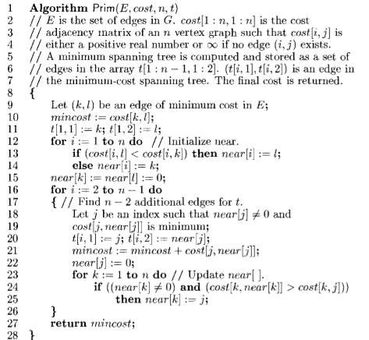

Slide 5
Complete Graph
B
4
C
4
2
1
A
4
E
1
F
D
2
3
10
G
5
5
6
3
4
I
H
2
3
J

Slide 6
Old Graph
New Graph
B
4
C
4
B
4
C
2
1
4
2
1
A
4
E
1
F
A
4
E
F
1
D
2
3
10
D
2
3
G
5
10
G
5
5
6
3
5
6
3
4
I
4
H
I
3
H
2
J
2
3
J

Slide 7
Old Graph
New Graph
B
4
C
4
B
4
C
2
1
4
2
1
A
4
E
1
F
A
4
E
F
1
D
2
3
10
D
2
3
G
5
10
G
5
5
6
3
5
6
3
4
I
4
H
I
3
H
2
J
2
3
J

Slide 8
Old Graph
New Graph
B
4
C
4
B
4
C
2
1
4
2
1
A
4
E
1
F
A
4
E
F
1
D
2
3
10
D
2
3
G
5
10
G
5
5
6
3
5
6
3
4
I
4
H
I
3
H
2
J
2
3
J

Slide 9
Old Graph
New Graph
B
4
C
4
B
4
C
2
1
4
2
1
A
4
E
1
F
A
4
E
F
1
D
2
3
10
D
2
3
G
5
10
G
5
5
6
3
5
6
3
4
I
4
H
I
3
H
2
J
2
3
J

Slide 10
Old Graph
New Graph
B
4
C
4
B
4
C
2
1
4
2
1
A
4
E
1
F
A
4
E
F
1
D
2
3
10
D
2
3
G
5
10
G
5
5
6
3
5
6
3
4
I
4
H
I
3
H
2
J
2
3
J

Slide 11
Old Graph
New Graph
B
4
C
4
B
4
C
2
1
4
2
1
A
4
E
1
F
A
4
E
F
1
D
2
3
10
D
2
3
G
5
10
G
5
5
6
3
5
6
3
4
I
4
H
I
3
H
2
J
2
3
J

Slide 12
Old Graph
New Graph
B
4
C
4
B
4
C
2
1
4
2
1
A
4
E
1
F
A
4
E
F
1
D
2
3
10
D
2
3
G
5
10
G
5
5
6
3
5
6
3
4
I
4
H
I
3
H
2
J
2
3
J

Slide 13
Old Graph
New Graph
B
4
C
4
B
4
C
2
1
4
2
1
A
4
E
1
F
A
4
E
F
1
D
2
3
10
D
2
3
G
5
10
G
5
5
6
3
5
6
3
4
I
4
H
I
3
H
2
J
2
3
J

Slide 14
Old Graph
New Graph
B
4
C
4
B
4
C
2
1
4
2
1
A
4
E
1
F
A
4
E
F
1
D
2
3
10
D
2
3
G
5
10
G
5
5
6
3
5
6
3
4
I
4
H
I
3
H
2
J
2
3
J

Slide 15
Old Graph
New Graph
B
4
C
4
B
4
C
2
1
4
2
1
A
4
E
1
F
A
4
E
F
1
D
2
3
10
D
2
3
G
5
10
G
5
5
6
3
5
6
3
4
I
4
H
I
3
H
2
J
2
3
J

Slide 16
Complete Graph
Minimum Spanning Tree
B
4
C
4
B
4
C
2
1
4
2
1
A
4
E
1
F
A
E
F
1
D
2
3
10
D
2
G
5
G
5
6
3
3
4
I
H
I
3
H
2
J
2
3
J

Slide 17
Complexity Analysis
With Cost matrix :
With heaps:

Slide 18
Thank you

